Slide 1
CheckBox Control
Prof. Neeraj Bhargava
Kapil Chauhan
Department of Computer Science
School of Engineering & Systems Sciences
MDS University, Ajmer

Slide 2
CheckBox Control
Check box control is used to represents list of options to the user from which user can select none or any number of options.
Check Box control allow user to select or deselect particular option.

Slide 3

CheckBox Control
Each time user clicks on the Check Box its status get changed.
When check box is selected it has a checked status and when it is not selected it has Unchecked status

Slide 4
Properties of CheckBox
AutoCheck
It is used to specify weather CheckBox can automatically change its state or not when it is clicked. It has Boolean value. Default value is true.
CheckAlign
It is used to get or set alignment of the within CheckBox Control.
Checked
It is used to get or set Boolean value, which indicates weather CheckBoxControl is currently selected or not. It has Boolean value. True means selected. Default value is false.

Slide 5
Properties of CheckBox
BackColor
It is used to get or set background color of the CheckBox.
ForeColor
It is used to get or set color of the text associated with CheckBox.
Font
It is used to get or set font Style, Font Size, Font Face of the text associated with CheckBox.

Slide 6
Properties of CheckBox
TabStop
It is used to specify weather user can use TAB key to set focus on CheckBox Control or not. It has Boolean value. Default value is true.
Text
It is used to get or set text associated with CheckBox Control.
TextAlign
It is used to get or set alignment of the text that is associated with CheckBox Control.

Slide 7
Methods of the CheckBox
Show
It is used to show CheckBox Control at run time.
Hide
It is used to Hide CheckBox Control at run time.
Focus
It is used to set cursor or focus on CheckBox Control.

Slide 8
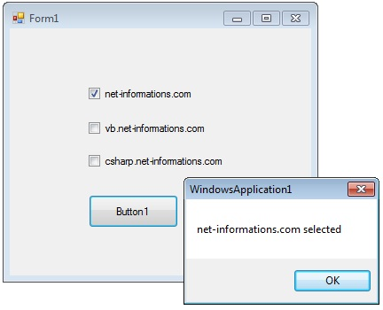
Example
CheckBoxes allow the user to make multiple selections from a number of options. You can click a check box to select it and click it again to deselect it.
CheckBox1.ThreeState = True

Slide 9
Assignment
Explain tools checkbox control with suitable example and discuss following.
(a) properties
(b) methods

